Slide 1
AWS Architecture Icons
Release 12-2022.01.31

Slide 2
Release 12-2022.01.31: What’s New?
1/3
For the latest assets package and full resources visit the AWS Architecture Center: https://aws.amazon.com/architecture/icons/
Analytics
Amazon MSK Connect / Resource Icon (slide 38)
AWS Data Exchange for APIs / Resource Icon (slide 38)
Compute
AWS Microservice Extractor for .NET / Resource Icon (slide 53)
M1 Mac Instance / Resource Icon (slide 53)
M6i Instance / Resource Icon (slide 53)
M6a Instance / Resource Icon (slide 53)
C7g Instance / Resource Icon (slide 54)
C6gn Instance / Resource Icon (slide 54)
C6i Instance / Resource Icon (slide 54)
Compute cont.
R6i Instance / Resource Icon (slide 55)
X2gd Instance / Resource Icon (slide 55)
X2idn Instance / Resource Icon (slide 55)
X2iedn Instance / Resource Icon (slide 55)
X2iezn Instance / Resource Icon (slide 55)
DL1 Instance / Resource Icon (slide 56)
Trn1 Instance / Resource Icon (slide 56)
G5 Instance / Resource Icon (slide 56)
G5g Instance / Resource Icon (slide 56)
VT1 Instance / Resource Icon (slide 56)
Im4gn Instance / Resource Icon (slide 57)
Compute cont.
Is4gen Instance / Resource Icon (slide 57)
I4i Instance / Resource Icon (slide 57)
AWS Outposts family (slide 59)
AWS Outposts rack (successor to AWS Outposts) (slide 59)
AWS Outposts servers (successor to AWS Outposts 1U and 2U servers) (slide 59)
NICE EnginFrame (slide 64)
Amazon Genomics CLI (slide 64)
Customer Enablement
AWS re:Post (slide 72)

Slide 3
Release 12-2022.01.31: What’s New?
2/3
For the latest assets package and full resources visit the AWS Architecture Center: https://aws.amazon.com/architecture/icons/
Database
Standard Access table class / Resource Icon (slide 74)
Standard–Infrequent Access table class / Resource Icon (slide 74)
Amazon MemoryDB for Redis (slide 77)
Developer Tools
AWS Cloud Control API (slide 83)
End User Computing
WorkSpaces Web / Resource Icon (slide 85)
Front-End Web & Mobile
AWS Amplify Studio / Resource Icon (slide 87)
Game Tech
Open 3D Engine (slide 89)
Internet of Things
Asset model / Resource Icon (slide 93)
Asset / Resource Icon (slide 93)
Properties / Resource Icon (slide 93)
Data streams / Resource Icon (slide 93)
Asset hierarchy / Resource Icon (slide 93)
AWS IoT ExpressLink (slide 94)
AWS IoT TwinMaker (slide 94)
AWS IoT RoboRunner (slide 94)
AWS IoT FleetWise (slide 94)
Machine Learning
Canvas / Resource Icon (slide 99)
Amazon SageMaker Studio Lab (slide 106)
Management & Governance
RUM / Resource Icon (slide 108)
Evidently / Resource Icon (slide 108)
Metrics Insights / Resource Icon (slide 108)
AWS Resilience Hub (slide 115)
Migration & Transfer
AWS Mainframe Modernization (slide 123)

Slide 4
Release 12-2022.01.31: What’s New?
3/3
For the latest assets package and full resources visit the AWS Architecture Center: https://aws.amazon.com/architecture/icons/
Migration & Transfer cont.
Refactor Spaces Services / Resource Icon (slide 122)
Refactor Spaces Applications / Resource Icon (slide 122)
Refactor Spaces Environments / Resource Icon (slide 122)
Analyzer / Resource Icon (slide 123)
Converter / Resource Icon (slide 123)
Developer / Resource Icon (slide 123)
Compiler / Resource Icon (slide 123)
Runtime / Resource Icon (slide 123)
Networking & Content Delivery
Application recovery controller / Resource Icon (slide 125)
Readiness checks / Resource Icon (slide 125)
Networking & Content Delivery cont.
Routing controls / Resource Icon (slide 125)
Network access analyzer / Resource Icon (slide 126)
AWS Private 5G (slide 129)
AWS Cloud WAN (slide 129)
Segment network / Resource Icon (slide 129)
Virtual PoP / Resource Icon (slide 129)
Storage
Intelligent-Tiering / Resource Icon (slide 146)
S3 Glacier Flexible Retrieval (successor to S3 Glacier) / Resource Icon (slide 149)
S3 Glacier Instant Retrieval / Resource Icon (slide 149)
Storage cont.
Amazon FSx for NetApp ONTAP (slide 150)
Amazon FSx for OpenZFS (slide 150)
Virtual machine / Resource Icon (slide 151)
Database / Resource Icon (slide 151)
Gateway / Resource Icon (slide 151)
Storage / Resource Icon (slide 151)
Compute / Resource Icon (slide 151)
AWS Backup Support for Amazon S3 / Resource Icon (slide 151)
AWS Backup Support for VMware workloads / Resource Icon (slide 151)
Virtual machine monitor / Resource Icon (slide 151)

Slide 5
Contents
Introduction
System
Guidelines
Examples
Elements

Slide 6
Introduction
About the deck, and guidance for getting started

Slide 7
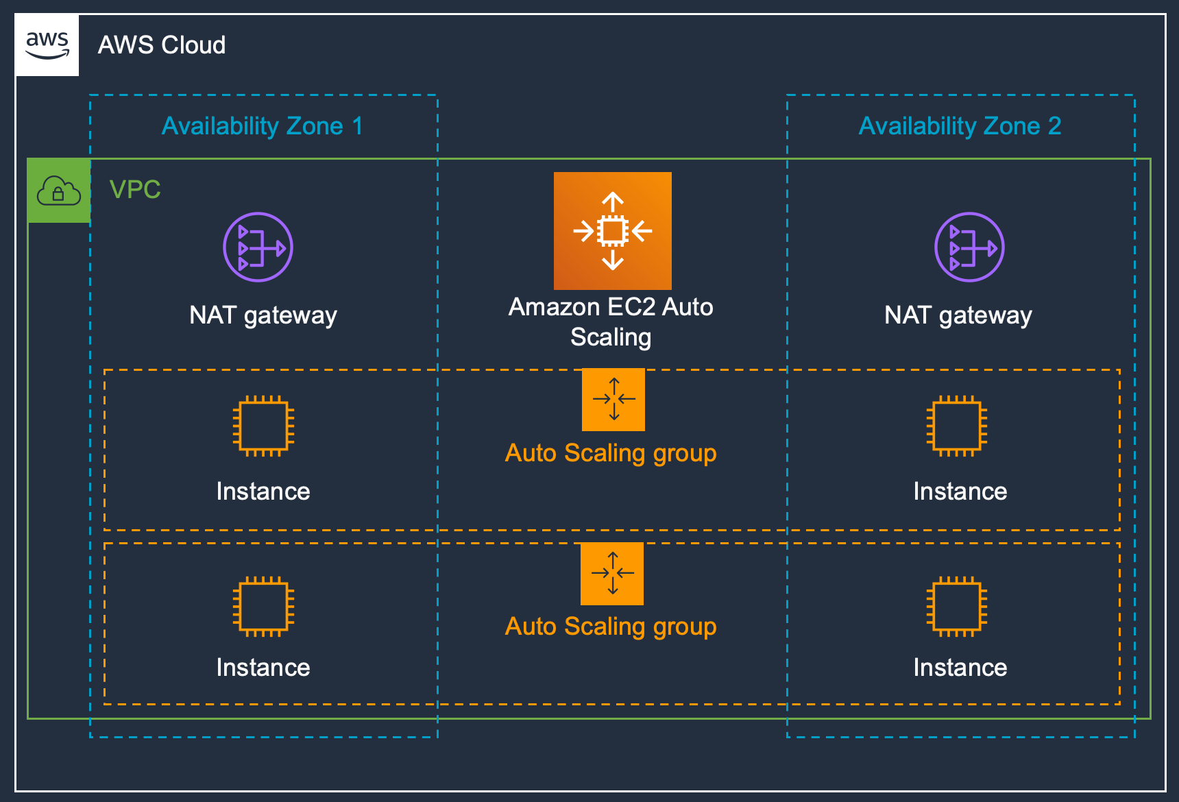
About AWS Architecture Icons
Architecture diagrams are a great way to communicate your design, deployment, and topology.
In this deck, you will find an official collection of AWS service icons, resources, and other tools to help you build customer-focused and consistent AWS architecture diagrams.
Customers and partners are permitted by AWS to use the icons to create architecture diagrams. They are designed to be simple so that you can easily incorporate them in your diagrams and put them in your whitepapers, presentations, datasheets, posters, or any technical material you like.

Slide 8
Before You Begin:
1
Check for the latest deck update.
Download the latest deck from the AWS Architecture Center.
2
Read the guidelines.
For specific element guidance and best practices, see the guidelines.
3
When in doubt, see the examples.
For completed diagrams, jump to the example pages. If you’re having trouble with a particular layout or object, use these as a blueprint.

Slide 9
System
An all-up look at the diagram system

Slide 10





System Elements
AWS Cloud
Groups
Arrows
Service icons
Show the connection between multiple services or resources
Describe a flow of information or connect different parts of a diagram
Represent an AWS service
Resource icons
General resource icons
Represent an AWS service resource
Apply to multiple services or categories

Slide 11





System Elements
Group icon
AWS Cloud
Availability Zone 1
Availability Zone 2
Layered groups
VPC
Service icon
NAT gateway
Amazon EC2 Auto Scaling
NAT gateway
Auto Scaling group
Instance
Instance
Auto Scaling group
Resource icon
Instance
Instance

Slide 12
Guidelines
Diagram and element guidance

Slide 13
Building a Diagram
Choose your deck style. The architecture deck is available for both light and dark backgrounds. Determine which best fits your need – light backgrounds tend to be used on the web, whereas dark backgrounds are used for in-person presentations or slide decks.
Start with the structure. Locate the groups (reference slides 24 & 25) to use for the underlying structure of your diagram.
Add architecture service or resource icons. If you downloaded the asset package from the AWS Architecture Center then you can search for your icon from your folder. Simply drag & drop or insert wherever you are building your diagram.
Connect the steps. Use the preset arrows to connect your steps and describe a workflow.
Add any final touches. You may use numbers to help convey a certain order within your diagram (reference example in slide 20).

Slide 14
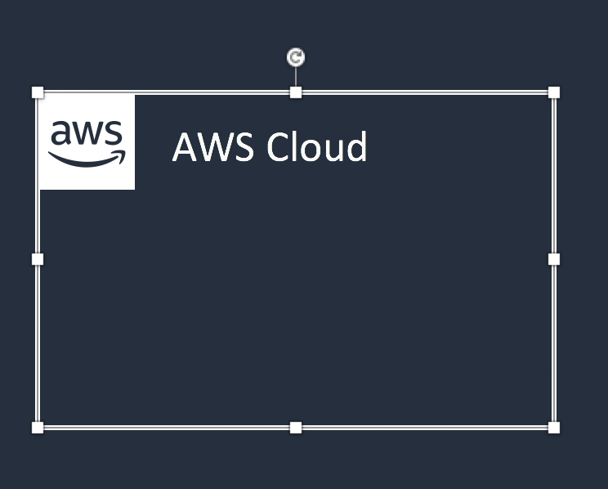


Groups
Each group consists of an icon and a label. Colors and lines help differentiate groups to make it easier for the user to read a diagram at a glance. Some groups cross multiple groups, such as Auto Scaling, whereas others are meant to layer inside one another, such as a VPC and subnets.
Resizing groups
Use the bottom-right corner of a group box to stretch or collapse to your desired size.
Layering groups
When you have groups within groups, each inner group should have about 0.05” buffer on each side.
DO:
Hold Shift down while resizing an icon to maintain a square.
Use a generic group type if the presets do not suit your needs.
Add a custom group if needed, reference slides 27 & 28.
VPC
Public subnet
DON’T:
Create groups with non-approved AWS icon(s).

Slide 15

Icons
Architecture service icons are designed to be used on both light and dark backgrounds. Please use the appropriate resource icons which come for both light and dark backgrounds. You can find the correct icon in the assets package download or in the version of the ppt. All icons may be renamed to better fit your use case.
Resizing icons
All icons in this deck are SVGs, allowing them to be scaled up or down depending on the diagram. To preserve icon integrity, be sure to hold down Shift while resizing.
DO:
Hold Shift down while resizing.
Change the resource icon text color when using a dark background.
Use the alternate light-bg service icon when appropriate.
DON’T:
Crop service icons.
Flip or rotate icons.
Change icon shapes.

Slide 16
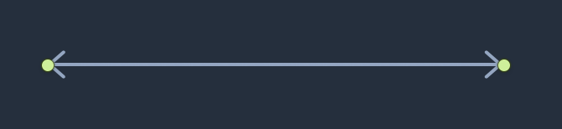
Arrows
Use arrows or lines to connect parts of a diagram or to show a workflow.
Use preset arrows
Copy the preset arrows into your diagram to maintain the correct formatting. To edit, click on the arrow and hold down Shift.
Create new arrows
Preset arrows use the “Open Arrow” in Size 4.
When in doubt, use the default
If the arrow shape that you need is not available in the sample arrows, use the default arrows.
DO:
Use the preset arrow provided in the Elements section.
Use straight lines and right angles to connect objects.
Default Arrow
+ Open Arrow
+ Size 4
DON’T:
Create diagonal lines.
Use anything beside preset or default arrows.
Hold Shift

Slide 17

Icon Labels
The icon and icon label are separated to allow for adjustment or abbreviation. The service icon label should be 12pt and the resource icon label 11pt to show hierarchy. You may change the color of the label depending on your scenario i.e. dark vs light background. Do not go smaller than 11pt as it impairs our accessibility standards.
Name wrapping and line breaks
AWS service names should fit on one or two lines. AWS or Amazon should always be accompanied by the service name. Lines should never break mid-word.
Short forms
To save space when using a service multiple times in a diagram, you may use the short service forms instead of the full name. For example, Amazon EC2.
DO:
Modify color or text size if necessary.
Break a line after the second word in the service name.
Amazon QuickSight
Amazon QuickSight
Amazon Quick- Sight
DON’T:
Amazon should be on the same line as the first word in the service name.
Use short forms without first mentioning the full service name somewhere in the document.
Duplicate short forms for different services, such as ELB for Elastic Beanstalk and Elastic Load Balancing.
Break a line in the middle of a word.
Lines should never break mid-word, and should fit on two lines max.

Slide 18
Examples
The system in action

Slide 19



Example: Git to S3 Webhooks
AWS Cloud
Amazon S3
SSH key bucket
Git push
Third-party Git repository
Git webhook
Git users
AWS KMS key
AWS Lambda
AWS Lambda
Amazon S3 output bucket

Slide 20


Example: Chef Automate Architecture on AWS
AWS Cloud
Availability Zone
VPC
Internet gateway
Chef Knife uploads cookbooks.
Knife bootstraps and communicates with nodes.
Chef client processes run list.
Public subnet
1
Chef Automate
3
2
Chef workstation (local Chef repo)
Chef node
10.0.0.0/19
10.0.0.0/16

Slide 21
Elements
Resources to use when building your diagram

Slide 22
Icon Categories
Click a category to jump to slide (must be in Presentation mode)
General Resources
Analytics
Application Integration
AWS Cost Management
Blockchain
Business Applications
Compute
Contact Center
Containers
Customer Enablement
Database
Developer Tools
End User Computing
Front-End Web & Mobile
Game Tech
Internet of Things
Machine Learning
Management & Governance
Media Services
Migration & Transfer
Networking & Content Delivery
Quantum Technologies
Robotics
Satellite
Security, Identity, & Compliance
Serverless
Storage
VR & AR

Slide 23
General Resources

Slide 24












Groups – Dark Backgrounds
1/9
*
AWS Cloud
AWS Cloud
Region
Availability Zone
Security group
Auto Scaling group
VPC
Private subnet
Public subnet
Server contents
Corporate
data center
EC2 instance contents
Spot Fleet
AWS account
AWS IoT Greengrass Deployment
AWS IoT Greengrass
Elastic Beanstalk container
AWS Step Functions workflow
Generic group
Generic group
*
In certain regions (i.e. China), AWS does not own the rights for the logo using the letters “AWS.” Per our guidelines, use the group with the AWS logo except in regions where the AWS logo cannot be used. You may use the group with the cloud icon in those cases.

Slide 25













Groups – Light Backgrounds
2/9
*
AWS Cloud
AWS Cloud
Region
Availability Zone
Security group
Auto Scaling group
VPC
Private subnet
Public subnet
Server contents
Corporate
data center
EC2 instance contents
Spot Fleet
AWS account
AWS IoT Greengrass Deployment
AWS IoT Greengrass
Elastic Beanstalk container
AWS Step Functions workflow
Generic group
Generic group
*
In certain regions (i.e. China), AWS does not own the rights for the logo using the letters “AWS.” Per our guidelines, use the group with the AWS logo except in regions where the AWS logo cannot be used. You may use the group with the cloud icon in those cases.

Slide 26
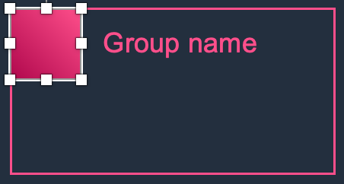
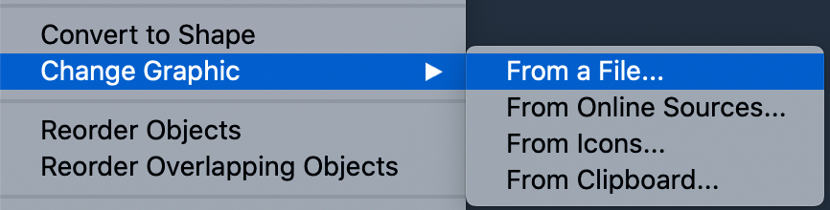
Create a Custom Group for a Service
3/9
Download the asset package. Go to the AWS Architecture Icons webpage and download the asset package to your desktop.
Copy the appropriate group box into your own slide (reference slides 27 & 28). Right-click on the square icon and choose Change Graphic > From a File.
Find the service icon. Navigate to the architecture service icon DELIVERABLES folder in the asset package, then look for the appropriate category folder the service icon lives in.
Insert the service icon. In the Arch_32 folder, select the architecture service icon SVG file (do not choose a PNG file, image quality will be degraded), then click Insert.

Slide 27







Create a Custom Group for a Service – Dark Backgrounds
4/9
3/8
Select the category color your service lives in to start creating your custom group (reference slide 26 for instructions).
Group name
Group name
Group name
Group name
Analytics
Game Tech
Networking & Content Delivery
Serverless
Application Integration
Management & Governance
VR & AR
AWS Cost Management
Internet of Things
Storage
End User Computing
Machine Learning
Migration & Transfer
Group name
Group name
Group name
Blockchain
Compute
Containers
Media Services
Quantum Technologies
Business Applications
Contact Center
Front-End Web & Mobile
Robotics
Security, Identity & Compliance
Customer Enablement
Database
Developer Tools
Satellite

Slide 28
Create a Custom Group for a Service – Light Backgrounds
5/9
Select the category color your service lives in to start creating your custom group (reference slide 26 for instructions).
Group name
Group name
Group name
Group name
Analytics
Game Tech
Networking & Content Delivery
Serverless
Application Integration
Management & Governance
VR & AR
AWS Cost Management
Internet of Things
Storage
End User Computing
Machine Learning
Migration & Transfer
Group name
Group name
Group name
Blockchain
Compute
Containers
Media Services
Quantum Technologies
Business Applications
Contact Center
Front-End Web & Mobile
Robotics
Security, Identity & Compliance
Customer Enablement
Database
Developer Tools
Satellite

Slide 29
Arrows – Dark Backgrounds
6/9

Slide 30
Arrows – Light Backgrounds
7/9

Slide 31
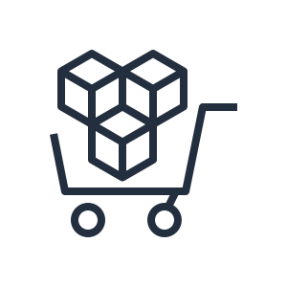























General Icons – Dark Backgrounds
8/9
AWS Marketplace
Client
Disk
Forums
Generic database
Internet
Internet alt1
Internet alt2
Mobile client
Firewall
Email
Multimedia
Office building
SAML token
SSL padlock
Tape storage
Traditional server
User
Users
Toolkit
SDK
Gear
Documents
Camera
Question

Slide 32
























General Icons – Light Backgrounds
9/9
AWS Marketplace
Client
Disk
Forums
Generic database
Internet
Internet alt1
Internet alt2
Mobile client
Firewall
Email
Multimedia
Office building
SAML token
SSL padlock
Tape storage
Traditional server
User
Users
Toolkit
SDK
Gear
Documents
Camera
Question

Slide 33

Analytics
STANDARD CATEGORY ICON

Slide 34







Analytics
1/5
Amazon CloudSearch
Amazon EMR
Amazon Kinesis
Search documents
Cluster
HDFS
cluster
EMR engine

Slide 35




Analytics
2/5
Amazon Kinesis Video Streams
Amazon Kinesis Data Streams
Amazon Kinesis Data Firehose
Amazon Kinesis Data Analytics

Slide 36






Analytics
3/5
AWS Glue
AWS Glue Elastic Views
Amazon Athena
Amazon OpenSearch Service
(successor to Amazon Elasticsearch Service)
Crawler
AWS Glue Data Catalog

Slide 37




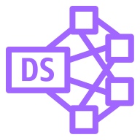

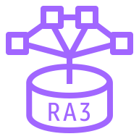

Analytics
4/5
Amazon Redshift
Amazon QuickSight
AWS Lake Formation
AWS Data Pipeline
Dense compute node
Dense storage node
Data lake
RA3
Redshift ML

Slide 38






Analytics
5/5
Amazon Managed Streaming for Apache Kafka
AWS Data Exchange
AWS Glue DataBrew
Amazon FinSpace
Amazon MSK Connect
AWS Data Exchange for APIs

Slide 39

Application Integration
STANDARD CATEGORY ICON

Slide 40



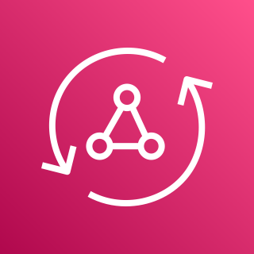






Application Integration
1/3
Amazon Simple Notification Service (Amazon SNS)
Amazon Simple Queue Service (Amazon SQS)
Amazon MQ
AWS AppSync
Email notification
Message
Broker
HTTP notification
Queue
Topic

Slide 41











Application Integration
2/3
AWS Step Functions
Amazon EventBridge
AWS Console Mobile Application
AWS Express Workflows
Event
Rule
Default
event bus
Custom
event bus
SaaS
event bus
Schema registry
Schema

Slide 42




Application Integration
3/3
Amazon AppFlow
Amazon Managed Workflows for Apache Airflow
Amazon API Gateway
Endpoint

Slide 43

AWS Cost Management
STANDARD CATEGORY ICON

Slide 44




AWS Cost Management
1/2
AWS Budgets
AWS Cost & Usage Report
AWS Cost Explorer
Reserved Instance (RI) Reporting

Slide 45


AWS Cost Management
2/2
Savings Plans
AWS Application Cost Profiler

Slide 46

Blockchain
STANDARD CATEGORY ICON

Slide 47



Blockchain
1/1
Amazon Managed Blockchain
Amazon Quantum Ledger Database (Amazon QLDB)
Blockchain

Slide 48

Business Applications
STANDARD CATEGORY ICON

Slide 49




Business Applications
1/3
Alexa for Business
Amazon Chime
Amazon WorkMail
Amazon Honeycode

Slide 50






Business Applications
2/3
Amazon Connect
Amazon Pinpoint
Amazon Simple Email Service (Amazon SES)
Amazon WorkDocs
Journey
Email

Slide 51
Business Applications
3/3
Amazon Chime SDK
Amazon Chime Voice Connector
Amazon Pinpoint APIs
Amazon WorkDocs SDK

Slide 52

Compute
STANDARD CATEGORY ICON

Slide 53




























Compute
1/12
Resource Icons
Amazon Elastic Compute Cloud (Amazon EC2)
AMI
Auto scaling
Elastic IP address
Rescue
AWS Microservice Extractor for .NET
Instance
Instances
Spot Instance
Instance with CloudWatch
Habana Gaudi instance
Trainium instance
General-purpose instances
Mac instance
M1 Mac instance
T4g instance
T3 instance
T3a instance
T2 instance
M6g instance
M6gd instance
M6i instance
M6a instance
M5 instance
M5a instance
M5d instance
M5n instance
M5dn instance
M5zn instance
M4 instance
A1 instance

Slide 54











Compute
2/12
Amazon Elastic Compute Cloud (Amazon EC2)
Compute-optimized instances
C7g instance
C6g instance
C6gn instance
C6gd instance
C6i instance
C5 instance
C5d instance
C5a instance
C5ad instance
C5n instance
C4 instance

Slide 55












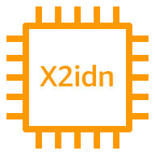



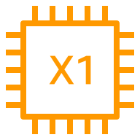

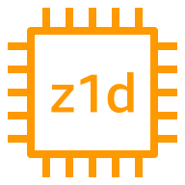
Compute
3/12
Amazon Elastic Compute Cloud (Amazon EC2)
Memory-optimized instances
R6g instance
R6i instance
R5 instance
R5a instance
R5d instance
R5ad instance
R5gd instance
R5b instance
R5n instance
Rdn instance
R4 instance
X2gd instance
X2idn instance
X2iedn instance
X2iezn instance
X1e instance
X1 instance
High Memory instance
z1d instance

Slide 56

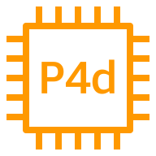













Compute
4/12
Amazon Elastic Compute Cloud (Amazon EC2)
Accelerated-computing instances
P4 instance
P4d instance
P3 instance
P3dn instance
P2 instance
DL1 instance
Trn1 instance
Inf1 instance
G5 instance
G5g instance
G4dn instance
G4ad instance
G3 instance
F1 instance
VT1 instance

Slide 57











Compute
5/12
Amazon Elastic Compute Cloud (Amazon EC2)
Storage-optimized instances
Im4gn instance
Is4gen instance
I4i instance
I3 instance
I3en instance
I2 instance
D2 instance
D3 instance
D3en instance
H1 instance
DB instance

Slide 58







Compute
6/12
AWS Elastic Beanstalk
AWS Lambda
Amazon Lightsail
Amazon EC2 Auto Scaling
Deployment
Lambda function
Application

Slide 59




Compute
7/12
AWS Outposts family
AWS Outposts rack
(successor to AWS Outposts)
AWS Outposts servers
(successor to AWS Outposts 1U and 2U servers)
AWS Serverless Application Repository

Slide 60




Compute
8/12
VMware Cloud on AWS
AWS Thinkbox Deadline
AWS Thinkbox XMesh
AWS Thinkbox Frost

Slide 61




Compute
9/12
AWS Thinkbox Krakatoa
AWS Thinkbox Sequoia
AWS Thinkbox Stoke
AWS Wavelength

Slide 62




Compute
10/12
AWS Compute Optimizer
AWS Local Zones
Amazon EC2 Image Builder
Bottlerocket

Slide 63




Compute
11/12
AWS ParallelCluster
NICE DCV
Elastic Fabric Adapter
AWS Nitro Enclaves

Slide 64




Compute
12/12
AWS App Runner
NICE EnginFrame
Amazon Genomics CLI
AWS Batch

Slide 65

Contact Center
CATEGORY ICON
COMING SOON

Slide 66
Contact Center
1/1
Amazon Connect

Slide 67
Containers
STANDARD CATEGORY ICON

Slide 68













Containers
1/2
Amazon Elastic Kubernetes Service (Amazon EKS)
Amazon Elastic Container Registry (Amazon ECR)
Amazon Elastic Container Service (Amazon ECS)
AWS Fargate
Registry
Container 1
Container 2
Image
Container 3
Service
Task
ECS Anywhere
Copilot CLI

Slide 69




Containers
2/2
Amazon EKS Anywhere
Amazon EKS Cloud
Amazon EKS Distro
Red Hat OpenShift

Slide 70

Customer Enablement
STANDARD CATEGORY ICON

Slide 71




Customer Enablement
1/2
AWS IQ
AWS Managed Services
AWS Professional Services
AWS Support

Slide 72



Customer Enablement
2/2
AWS Training and Certification
AWS Activate
AWS re:Post

Slide 73

Database
STANDARD CATEGORY ICON

Slide 74









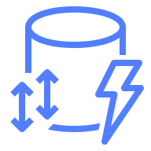



Database
1/5
Amazon Aurora
Amazon DocumentDB (with MongoDB compatibility)
Amazon DynamoDB
Attribute
Items
Amazon DynamoDB Accelerator (DAX)
Stream
Item
Table
Standard Access table class
Attributes
Global secondary
index
Standard–Infrequent Access table class

Slide 75





Database
2/5
Amazon Keyspaces (for Apache Cassandra)
AWS Database Migration Service (AWS DMS)
Amazon Neptune
Amazon Quantum Ledger Database (Amazon QLDB)
Database migration workflow or job

Slide 76







Database
3/5
Amazon Relational Database Service (Amazon RDS)
Amazon RDS on VMware
Amazon Timestream
Amazon ElastiCache
Cache node
ElastiCache
for Redis
ElastiCache for Memcached

Slide 77

Database
4/5
Amazon MemoryDB for Redis

Slide 78










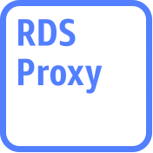




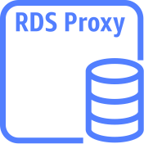
Database
5/5
Amazon Aurora instance
Amazon Aurora instance alternate
Amazon RDS instance
Amazon RDS
instance alternate
MySQL
instance
MySQL
instance alternate
Oracle
instance
Oracle
instance alternate
PostgreSQL instance
PostgreSQL
instance alternate
PIOPS instance
Amazon RDS
proxy instance alternate
MariaDB instance
MariaDB instance alternate
SQL Server
instance
SQL Server
instance alternate
Amazon RDS
proxy instance

Slide 79

Developer Tools
STANDARD CATEGORY ICON

Slide 80





Developer Tools
1/4
AWS Cloud9
AWS CodeBuild
AWS CodeCommit
AWS CodeDeploy
Cloud9

Slide 81




Developer Tools
2/4
AWS CodePipeline
AWS CodeStar
AWS Command Line Interface (AWS CLI)
AWS Tools and SDKs

Slide 82

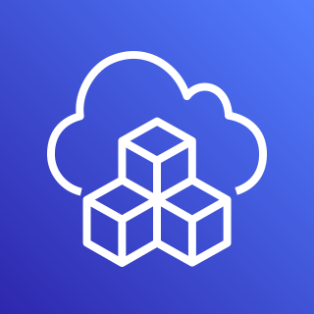


Developer Tools
3/4
AWS X-Ray
AWS Cloud Development Kit (AWS CDK)
AWS CodeArtifact
AWS CloudShell

Slide 83


Developer Tools
4/4
Amazon Corretto
AWS Cloud Control API

Slide 84

End User Computing
STANDARD CATEGORY ICON

Slide 85

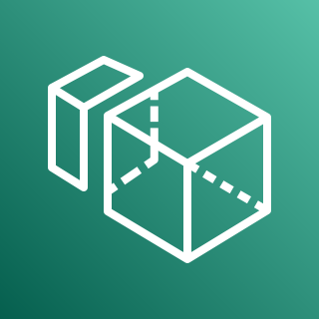


End User Computing
1/1
Amazon AppStream 2.0
Amazon WorkSpaces
Amazon WorkLink
WorkSpaces Web

Slide 86

Front-End Web & Mobile
STANDARD CATEGORY ICON

Slide 87









Front-End Web & Mobile
1/1
AWS Amplify
AWS Device Farm
Amazon Location Service
AWS Amplify Studio
Track
Place
Map
Geofence
Routes

Slide 88

Game Tech
STANDARD CATEGORY ICON

Slide 89



Game Tech
1/1
Amazon GameLift
Amazon Lumberyard
Open 3D Engine

Slide 90

Internet of Things
STANDARD CATEGORY ICON

Slide 91









Internet of Things
1/6
FreeRTOS
AWS IoT 1-Click
AWS IoT Analytics
AWS IoT Button
Channel
Dataset
Pipeline
Notebook
Data store

Slide 92





Internet of Things
2/6
AWS IoT Core
AWS IoT Device Defender
AWS IoT Device Management
AWS IoT Events
IoT device jobs

Slide 93



















Internet of Things
3/6
AWS IoT Greengrass
AWS IoT SiteWise
AWS IoT Things Graph
Connector
Stream manager
Artifact
Component
Asset model
Asset
Component machine learning
Component nucleus
Component private
Component public
Properties
Data streams
Interprocess communication
Protocol
Recipe
Asset hierarchy

Slide 94




Internet of Things
4/6
AWS IoT ExpressLink
AWS IoT TwinMaker
AWS IoT RoboRunner
AWS IoT FleetWise

Slide 95



























Internet of Things
5/6
IoT action
IoT actuator
IoT certificate
IoT desired state
IoT hardware board
IoT HTTP protocol
IoT HTTP/2 protocol
IoT MQTT protocol
IoT policy
IoT reported state
IoT rule
IoT sensor
IoT servo
IoT shadow
IoT simulator
IoT topic
Alexa skill
Alexa Voice Service
Alexa-enabled device
Echo
Fire TV
Fire TV Stick
Lambda function
Over-the-air update
Device gateway
AWS IoT Core for LoRaWAN protocol
LoRaWAN protocol

Slide 96


























Internet of Things
6/6
IoT thing bank
IoT thing bicycle
IoT thing camera
IoT thing car
IoT thing cart
IoT thing coffee pot
IoT thing door lock
IoT thing factory
IoT thing generic
IoT thing house
IoT thing lightbulb
IoT thing travel
IoT thing medical emergency
IoT thing police emergency
IoT thing utility
IoT thing windfarm
IoT thing humidity sensor
IoT thing vibration sensor
IoT thing temperature sensor
IoT thing temperature & humidity sensor
IoT thing temperature & vibration sensor
IoT thing relay
IoT thing stack light
IoT thing FreeRTOS device
IoT thing industrial PC
IoT thing PLC

Slide 97

Machine Learning
STANDARD CATEGORY ICON

Slide 98




Machine Learning
1/9
Amazon Comprehend
Amazon Elastic Inference
Amazon Forecast
Amazon Lex

Slide 99










Machine Learning
2/9
Amazon Personalize
Amazon Polly
Amazon Rekognition
Amazon SageMaker
Amazon Rekognition image
Notebook
Canvas
Amazon Rekognition video
Model
Train

Slide 100




Machine Learning
3/9
Amazon SageMaker Ground Truth
Amazon Textract
Amazon Transcribe
Amazon Translate

Slide 101




Machine Learning
4/9
AWS Deep Learning AMIs
AWS Deep Learning Containers
AWS DeepLens
AWS DeepRacer

Slide 102



Machine Learning
5/9
Apache MXNet on AWS
TensorFlow on AWS
AWS DeepComposer
Amazon Augmented AI (Amazon A2I)

Slide 103




Machine Learning
6/9
Amazon Fraud Detector
Amazon Kendra
Amazon CodeGuru
TorchServe

Slide 104




Machine Learning
7/9
Amazon Lookout for Equipment
Amazon Lookout for Metrics
Amazon Lookout for Vision
Amazon Monitron

Slide 105





Machine Learning
8/9
Amazon DevOps Guru
Amazon HealthLake
AWS Panorama
AWS Neuron
Insights

Slide 106

Machine Learning
9/9
Amazon SageMaker Studio Lab

Slide 107

Management & Governance
STANDARD CATEGORY ICON

Slide 108















Management & Governance
1/8
Amazon CloudWatch
AWS Auto Scaling
AWS CloudFormation
Alarm
Rule
RUM
Change set
Stack
Event (time-based)
Event (event-based)
Evidently
Template
Logs
Synthetics
Metrics Insights

Slide 109






Management & Governance
2/8
AWS Application Auto Scaling
AWS Config
AWS License Manager
AWS Personal Health Dashboard
License blending
Application discovery

Slide 110











Management & Governance
3/8
AWS Management Console
AWS OpsWorks
AWS CloudTrail
Apps
Instances
Monitoring
Permissions
Deployments
Layers
Resources
Stack2

Slide 111











Management & Governance
4/8
AWS Service Catalog
AWS Systems Manager
Automation
Documents
Patch Manager
Parameter Store
OpsCenter
Inventory
Maintenance Windows
State Manager
Run Command

Slide 112








Management & Governance
5/8
AWS Trusted Advisor
AWS Well-Architected Tool
AWS Control Tower
Checklist
cost
Checklist
performance
Checklist
security
Checklist
fault tolerant
Checklist

Slide 113
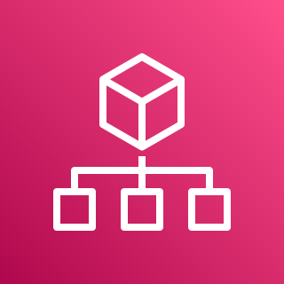






Management & Governance
6/8
AWS Organizations
AWS AppConfig
AWS Chatbot
AWS Backint Agent
Account
Organizational unit
Management account

Slide 114




Management & Governance
7/8
AWS Fault Injection Simulator
Amazon Managed Service for Grafana
Amazon Managed Service for Prometheus
AWS Distro for OpenTelemetry

Slide 115




Management & Governance
8/8
AWS Proton
AWS Launch Wizard
AWS Systems Manager Incident Manager
AWS Resilience Hub

Slide 116

Media Services
STANDARD CATEGORY ICON

Slide 117





Media Services
1/4
Amazon Elastic Transcoder
Amazon Kinesis Video Streams
AWS Elemental MediaConnect
AWS Elemental MediaConvert
AWS Cloud Digital Interface

Slide 118




Media Services
2/4
AWS Elemental MediaLive
AWS Elemental MediaPackage
AWS Elemental MediaStore
AWS Elemental MediaTailor

Slide 119

Media Services
3/4
AWS Elemental Conductor
AWS Elemental Delta
AWS Elemental Live
AWS Elemental Server

Slide 120



Media Services
4/4
AWS Elemental Appliances & Software
Amazon Interactive Video Service
AWS Elemental Link
Amazon Nimble Studio

Slide 121

Migration & Transfer
STANDARD CATEGORY ICON

Slide 122











Migration & Transfer
1/2
AWS Application Discovery Service
AWS Transfer Family
AWS DataSync
AWS Migration Hub
AWS FTPS
Agent
Refactor Spaces services
AWS SFTP
Refactor Spaces applications
AWS FTP
Refactor Spaces environments

Slide 123









Migration & Transfer
2/2
AWS Server Migration Service (AWS SMS)
AWS Application Migration Service
AWS Migration Evaluator
AWS Mainframe Modernization
Analyzer
Compiler
Converter
Runtime
Developer

Slide 124

Networking & Content Delivery
STANDARD CATEGORY ICON

Slide 125






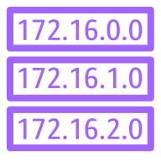








Networking & Content Delivery
1/5
AWS Transit Gateway
Amazon CloudFront
Amazon Route 53
Download distribution
Edge location
Hosted zone
Route table
Readiness checks
Streaming distribution
Functions
Resolver
Resolver DNS firewall
Routing controls
Resolver query logging
Application recovery controller

Slide 126
















Networking & Content Delivery
2/5
Amazon Virtual Private Cloud (Amazon VPC)
Customer gateway
Internet gateway
VPN gateway
Flow logs
Endpoints
Router
Traffic mirroring
NAT gateway
Elastic network interface
Elastic network adapter
Network access control list
VPN connection
Peering connection
Reachability analyzer
Carrier gateway
Network access analyzer

Slide 127













Networking & Content Delivery
3/5
AWS App Mesh
AWS Cloud Map
AWS Direct Connect
AWS Global Accelerator
Mesh
Virtual
gateway
Service
Gateway
Virtual node
Virtual router
Namespace
Virtual service
Resource

Slide 128








Networking & Content Delivery
4/5
AWS Client VPN
AWS Site-to-Site VPN
Elastic Load Balancing
AWS PrivateLink
Application Load Balancer
Network Load Balancer
Classic Load Balancer
Gateway Load Balancer

Slide 129




Networking & Content Delivery
5/5
AWS Cloud WAN
AWS Private 5G
Segment network
Virtual PoP

Slide 130

Quantum Technologies
STANDARD CATEGORY ICON

Slide 131










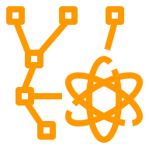

Quantum Technologies
1/1
Amazon Braket
Chandelier
Chip
QPU
Simulator
Simulator 1
Simulator 2
Simulator 3
Simulator 4
State vector
Tensor network
Noise simulator

Slide 132

Robotics
STANDARD CATEGORY ICON

Slide 133





Robotics
1/1
AWS RoboMaker
Cloud extensions ROS
Development environment
Fleet
management
Simulation

Slide 134

Satellite
STANDARD CATEGORY ICON

Slide 135

Satellite
1/1
AWS Ground Station

Slide 136

Security, Identity, & Compliance
STANDARD CATEGORY ICON

Slide 137





Security, Identity, & Compliance
1/6
Amazon Cloud Directory
Amazon Cognito
Amazon GuardDuty
Amazon Inspector
Agent

Slide 138





Security, Identity, & Compliance
2/6
Amazon Macie
AWS Artifact
AWS Certificate Manager (ACM)
AWS CloudHSM
Certificate authority

Slide 139








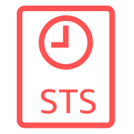








Security, Identity, & Compliance
3/6
AWS Directory Service
AWS Firewall Manager
AWS Identity and Access Management (IAM)
Simple AD
Add-on
Permissions
MFA token
AWS STS
AWS STS alternate
Long-term security
credential
AD Connector
Encrypted data
Data encryption key
Temporary security credential
AWS Managed Microsoft AD
Role
AWS IAM Access Analyzer

Slide 140






Security, Identity, & Compliance
4/6
AWS Key Management Service (AWS KMS)
AWS Secrets Manager
AWS Security Hub
AWS Shield
Finding
AWS Shield Advanced

Slide 141











Security, Identity, & Compliance
5/6
AWS Single Sign-On
AWS WAF
Amazon Detective
AWS Resource
Access Manager
Rule
Managed rule
Filtering rule
Labels
Bot
Bad bot
Bot control

Slide 142




Security, Identity, & Compliance
6/6
AWS Audit Manager
AWS Network Firewall
AWS Signer
Endpoints

Slide 143

Serverless
STANDARD CATEGORY ICON

Slide 144

Serverless
1/1
Serverless is a way to describe the services that enable you to build and run applications without thinking about servers. AWS has serverless services for all layers of your stack. In many public forums, like our marketing website, we list these services under the Serverless heading because it improves discoverability.
When it comes to building an architecture diagram, it’s more intuitive to use a functional categorization. Please find the architecture icon for each serverless service in its functional category. You can use the serverless category icon to describe serverless applications or architectures.
Compute
Containers
Application Integration
Storage
Database
AWS Lambda
AWS Fargate
Amazon SQS
Amazon SNS
Amazon EventBridge
AWS Step Functions
AWS AppSync
Amazon S3
Amazon DynamoDB
Amazon RDS Proxy
Amazon Aurora Serverless

Slide 145

Storage
STANDARD CATEGORY ICON

Slide 146






















Storage
1/6
Amazon Elastic Block Store (Amazon EBS)
Amazon Elastic File System (Amazon EFS)
AWS Storage Gateway
Snapshot
Multiple volumes
File system
One Zone
Noncached
volume
Cached
volume
Amazon FSx
File Gateway
Volume
Volume gp3
One Zone Infrequent Access
Standard
Virtual tape
library
Tape
Gateway
Amazon S3
File Gateway
Amazon Data Lifecycle Manager
Standard–Infrequent Access
Intelligent-Tiering
Volume
Gateway
File
gateway

Slide 147




Storage
2/6
Amazon FSx for Lustre
Amazon FSx for Windows File Server
Amazon FSx
CloudEndure Disaster Recovery
File system
File system

Slide 148

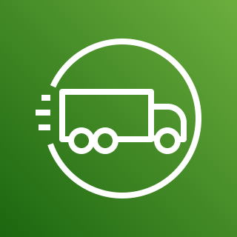



Storage
3/6
AWS Snowball Edge
AWS Snowmobile
AWS Snowball
AWS Snowcone
Snowball import-export

Slide 149


















Storage
4/6
Amazon Simple Storage Service (Amazon S3)
S3 Standard
S3 Intelligent- Tiering
S3 Standard-IA
S3 One Zone-IA
S3 Glacier Flexible Retrieval (successor to S3 Glacier)
S3 Glacier Deep Archive
S3 Glacier Instant Retrieval
S3 on Outposts
Bucket
Bucket with
objects
Replication
S3 Replication Time Control
S3 Storage Lens
Access points
VPC access points
Object
S3 Object Lambda
S3 Object Lambda access points

Slide 150






Storage
5/6
Amazon S3 on Outposts
Amazon Simple Storage Service Glacier
Amazon FSx for NetApp ONTAP
Amazon FSx for OpenZFS
Vault
Archive

Slide 151















Storage
6/6
AWS Backup
Backup plan
Backup vault
Virtual machine
Virtual machine monitor
AWS Backup support for VMware workloads
Recovery point objective
Recovery time objective
Database
Storage
AWS Backup support for Amazon S3
Compliance reporting
Backup restore
Gateway
Compute

Slide 152

VR & AR
STANDARD CATEGORY ICON

Slide 153
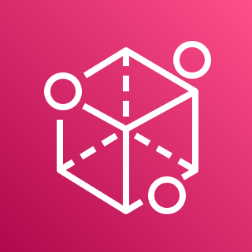
VR & AR
1/1
Amazon Sumerian

